Slide 1

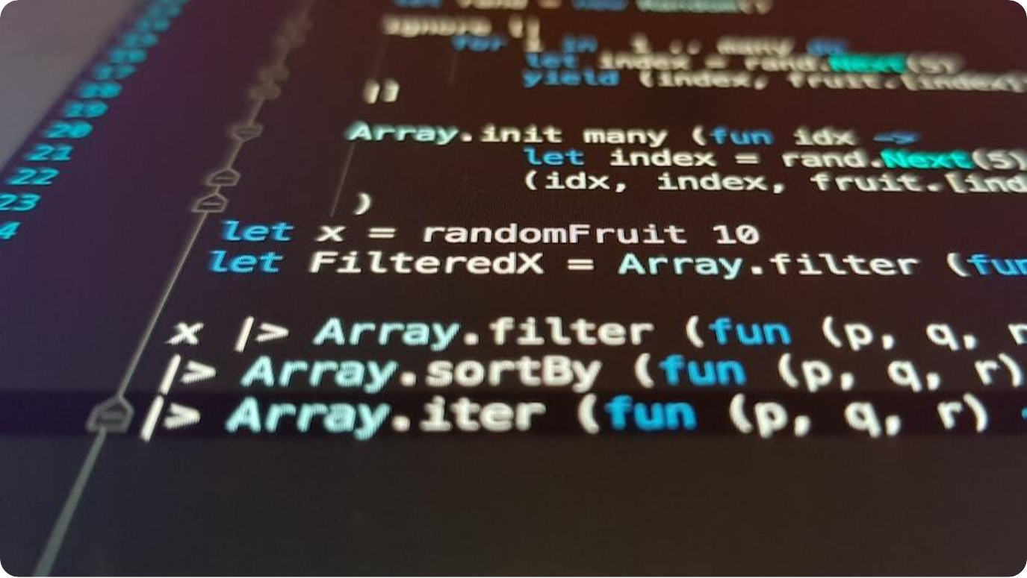
Welcome to Day 4
Mastering Python Functions
Trainer: Chandramouli Das: Sr Data Scientist
Today's Theme: Understand and write reusable code with Python functions
Learning Focus: Function definition, arguments, scope, and best practices
Hands-On: Mini project, code review, and live examples
Photo by Ilija Boshkov on Unsplash
Notes:
Welcome to Day 4! I’m Your Name, and today we focus on one of the most powerful tools in programming: functions. We’ve already used built-in ones like `print()`—now you’ll learn to define and organize your own.
Today’s journey includes writing functions, understanding parameters and return values, exploring scope, and mastering best practices. The session is practical and highly interactive.
Let’s dive in and see how functions help structure code, reduce repetition, and make your programs scalable and professional.

Slide 2
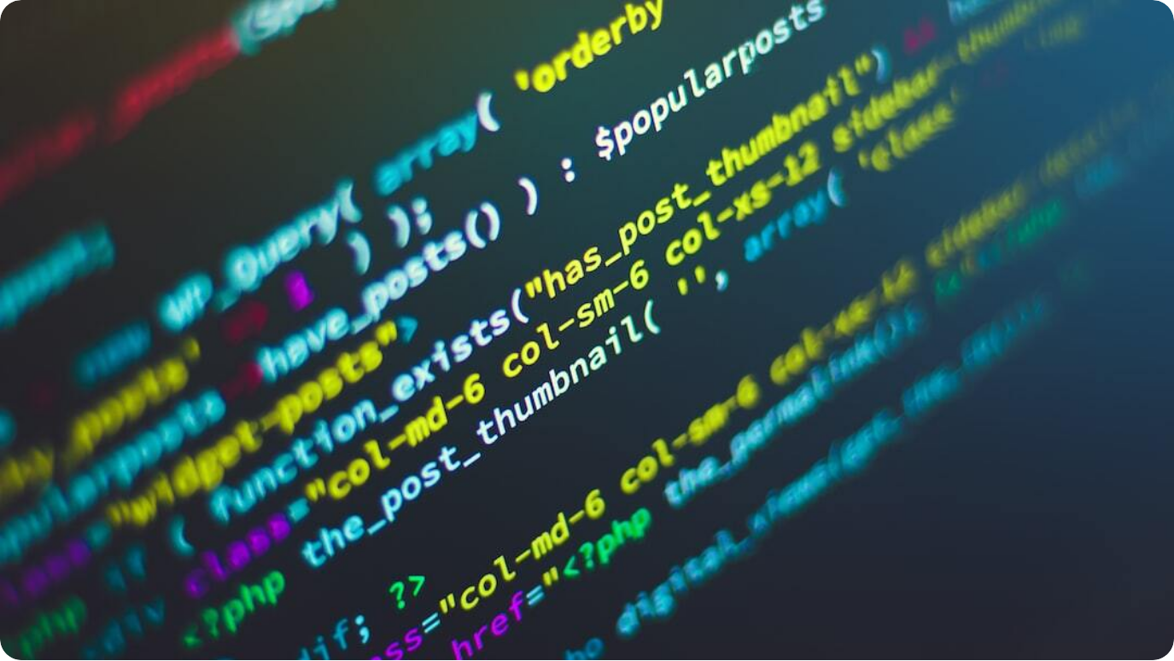
Why Use Functions?
Purpose and Benefits of Functions
Reusability: Functions let you reuse code blocks, reducing duplication.
Organization: Breaks large programs into manageable chunks.
Testing and Debugging: Functions make it easier to isolate and fix errors.
Readability: Descriptive function names make code self-explanatory.
Photo by Shahadat Rahman on Unsplash
Notes:
Functions are essential for writing clean, scalable code. They allow you to encapsulate logic and reuse it multiple times across your program, avoiding redundancy.
They also help in organizing code. A complex problem is easier to solve when broken down into small, manageable parts. This modular structure improves testing and debugging, as you can isolate logic into units.
With clear, descriptive function names, your code becomes easier to read and understand—especially in team environments or long-term projects.

Slide 3
Defining Functions
Basic Syntax and Structure
Keyword `def`: Begin every function with the def keyword followed by a name.
Parameters: Input variables specified inside parentheses.
Indentation Block: Function logic is indented below the def line.
Return Statement: Optionally return output to the caller using return.
Photo by Ilija Boshkov on Unsplash
Notes:
To define a function in Python, start with the `def` keyword, followed by the function name and a pair of parentheses. Inside the parentheses, you may specify parameters that act as inputs to the function.
After the definition line, include an indented block of code—the function body—that performs a specific task. To output a result, use the `return` statement.
This structure enables clear, reusable logic. For example:
```python
def greet(name):
return "Hello, " + name
```

Slide 4

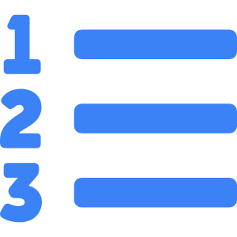


Function Parameters and Arguments
Handling Input in Functions
Parameters vs Arguments
Parameters are variables listed in the function; arguments are values passed.
Positional Arguments
Assigned based on order—they must match parameter sequence.
Keyword Arguments
Arguments passed with key=value syntax for clarity.
Mixing Types
Use keyword arguments after all positional ones.
Notes:
When defining functions, parameters are placeholders that define what inputs the function expects. When calling the function, you provide arguments that fill those placeholders.
Python supports two main types of arguments: positional and keyword. Positional arguments are matched in order, while keyword arguments use `key=value` format and are more readable, especially in long parameter lists.
You can mix both in a function call, but positional arguments must come first. This structure enhances flexibility and readability in function usage.

Slide 5
Return Statements and Scope
Controlling Output and Variable Lifetime
Return Keyword: Ends function and returns a result to the caller.
Multiple Returns: Functions can return multiple values as tuples.
Scope: Local variables are only accessible inside the function.
Global Access: Use global keyword to modify global variables.
Photo by Ilija Boshkov on Unsplash
Notes:
The `return` statement is how a function sends a result back to its caller. Once `return` is executed, the function ends—even if more code follows. This is crucial for managing program flow and collecting outputs.
Functions can return multiple values, usually as a tuple. This is handy for splitting calculations into related outputs.
Scope determines variable visibility. Variables defined inside a function are local to that function and disappear once it ends. If you want to modify a global variable from inside, you must use the `global` keyword—but use it sparingly.

Slide 6



Positional vs Keyword Arguments
Flexible Function Calls
Positional
Values are matched based on their order in the function call.
Keyword
Values are passed using parameter names for clarity.
Mixed Usage
Combine both types, placing positional first.
Clarity
Keyword arguments improve readability and reduce errors.
Notes:
Understanding the difference between positional and keyword arguments is key to writing clear and flexible functions. With positional arguments, order matters—each value is assigned based on position.
With keyword arguments, values are assigned by name, which can make the function call more readable and less prone to bugs, especially when dealing with multiple or optional parameters.
Best practice: use keyword arguments for optional or less obvious parameters, and keep positional arguments concise and clear. This improves both functionality and maintainability.

Slide 7

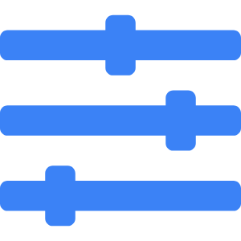

Default Parameter Values
Making Arguments Optional
Syntax
Assign a default value in the function definition.
Optional Arguments
Caller can omit argument if default is acceptable.
Flexible Calls
Enables simpler usage while preserving full capability.
Example
def greet(name="Guest") → greet() prints 'Hello, Guest'
Notes:
Default arguments make your functions more flexible. By assigning default values in the function definition, callers can omit parameters when the defaults are sufficient.
This is especially helpful when some parameters are optional or have common values. It allows the same function to support both simple and detailed use cases.
For instance:
```python
def greet(name="Guest"):
print("Hello, " + name)
```
Calling `greet()` prints 'Hello, Guest', while `greet("Alice")` prints 'Hello, Alice'.

Slide 8
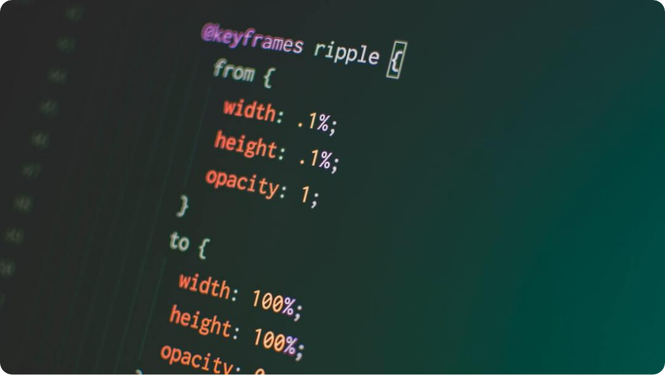
Variable-Length Arguments
Using *args and **kwargs
*args: Collects extra positional arguments into a tuple.
**kwargs: Collects extra keyword arguments into a dictionary.
Flexible Calls: Functions handle unknown or optional inputs gracefully.
Common Uses: Useful in wrappers, decorators, and APIs.
Photo by Pankaj Patel on Unsplash
Notes:
Sometimes you don't know how many arguments a function will need. Python allows you to define functions with variable-length arguments using `*args` and `**kwargs`.
`*args` gathers extra positional arguments into a tuple. `**kwargs` collects keyword arguments into a dictionary. This lets your function accept flexible inputs and handle optional parameters effectively.
Example:
```python
def info(*args, **kwargs):
print(args)
print(kwargs)
```
This design pattern is common in decorators, API wrappers, and plugin interfaces.

Slide 9

Practical Function Examples
Real Usage for Automation and Logic
Greeting Function: Automates personalized messages.
Simple Calculator: Encapsulates arithmetic in callable units.
Data Processor: Applies transformations on lists or dictionaries.
Use Case: Simplifies code reuse across projects.
Photo by Kelly Sikkema on Unsplash
Notes:
To solidify function concepts, let’s walk through some practical examples. A greeting function like `greet(name)` can customize outputs with a single call.
A simple calculator function accepts two numbers and an operation, returning the result. This keeps logic organized and reusable across apps.
You can also define functions for transforming or summarizing data—like extracting initials or computing averages from a list.
These real-world examples show how functions help modularize code, automate logic, and speed up development.

Slide 10
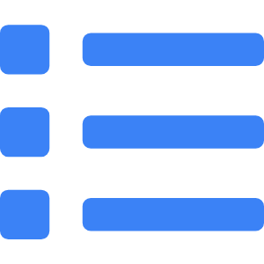

Mini Quiz: Predict the Output
Quick Test on Functions
Function Behavior
Identify what the function will return.
Example Code
def test(x): return x * 2 test(3)
Options
A) 3 B) 6 C) Error D) 2
Correct Answer
B — Function multiplies input by 2.
Notes:
Let’s see how well you’ve understood function behavior. Consider this simple Python function:
```python
def test(x):
return x * 2
print(test(3))
```
What does it output?
If you chose 6, you’re correct. The input `3` is passed to the function, doubled, and returned. This highlights how function calls work and how arguments flow into defined parameters.
Quizzes like this reinforce syntax, logic flow, and return value understanding.

Slide 11
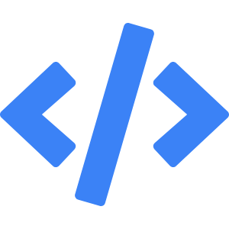

Functions Calling Functions
Nested Execution and Modularity
Concept
One function can invoke another, forming call chains.
Modular Logic
Keeps each function focused and reusable.
Code Example
def total(a, b): return add(a, b) * 2
Use Case
Ideal for structured logic in projects and APIs.
Notes:
In Python, functions can call other functions. This allows you to break complex tasks into smaller, manageable pieces. For example, one function can handle input validation, and another performs the main computation.
This modular approach improves readability, testing, and debugging. Imagine `total(a, b)` calling `add(a, b)` to reuse logic. It’s like building with Lego blocks—each function serves a purpose and can be reused.
This pattern is used in APIs, workflows, and data pipelines. Mastering this helps you think in layers and write more elegant, scalable code.

Slide 12
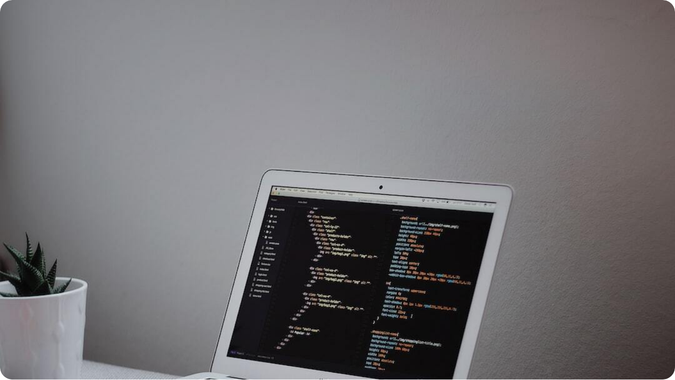
Understanding Scope
Global vs Local Variables
Local Scope: Variables defined inside a function, accessible only there.
Global Scope: Variables defined outside any function, accessible anywhere.
Shadowing: Local variables can override globals with the same name.
Use Wisely: Avoid modifying globals from within functions unless necessary.
Photo by Goran Ivos on Unsplash
Notes:
Scope defines where variables are accessible in your code. Python has two main types: local and global.
Local variables exist only within a function. Once the function finishes, those variables disappear. Global variables are declared outside functions and are accessible throughout the program.
If a local variable shares a name with a global one, it shadows the global version within its scope. Avoid this unless you have a specific reason.
Using clear scopes improves predictability and reduces bugs—especially in larger applications.

Slide 13
Lambda Functions
Anonymous One-Liners
Definition: Lambda is a small, unnamed function defined with the lambda keyword.
Syntax: lambda x: x * 2 defines a doubling function.
Use Cases: Short utility functions, key selectors in sort(), filter(), map().
Best Practice: Use for simplicity; avoid complex logic in lambdas.
Photo by Ilija Boshkov on Unsplash
Notes:
Lambda functions are compact, one-line alternatives to full `def` functions. They’re ideal for simple operations—like returning squares, filtering lists, or passing quick logic to another function.
Syntax is straightforward: `lambda x: x * 2` creates an anonymous function that doubles input `x`. These are commonly used with functions like `map()`, `filter()`, or `sorted()` where short expressions are useful.
Though handy, lambdas should remain simple. For complex logic, always prefer named functions for readability and debugging.

Slide 14
Built-in vs User-defined Functions
Leveraging Python's Capabilities
Built-in Functions: Available by default, like len(), print(), input(), sum().
User-defined Functions: Created using def to encapsulate logic specific to your needs.
Extend Functionality: Combine both for flexible, powerful programs.
When to Use: Use built-ins for simplicity, write your own for specialized tasks.
Photo by Ilija Boshkov on Unsplash
Notes:
Python provides a rich set of built-in functions like `len()`, `print()`, and `sum()`—no import required. These speed up development and handle common tasks efficiently.
User-defined functions, however, let you create custom logic tailored to your application. This helps encapsulate behavior and structure large codebases into smaller, logical units.
Combining both makes your code powerful and reusable. You can embed built-ins within your functions, or extend functionality by creating wrappers. Use the right type based on complexity, reusability, and clarity.

Slide 15
Best Practices for Functions
Write Clean, Modular Python Code
Single Responsibility: Each function should perform one specific task.
Meaningful Names: Function names should describe what they do.
Avoid Side Effects: Functions should ideally not alter external variables.
Use Docstrings: Explain purpose, parameters, and returns using triple-quoted strings.
Photo by Ilija Boshkov on Unsplash
Notes:
Great functions follow best practices that keep your code modular, understandable, and testable. Stick to the 'single responsibility' principle—each function should do one thing and do it well.
Choose clear, descriptive names. `calculate_salary()` is more meaningful than `func1()`. Avoid hidden side effects: modify external variables only when necessary, and always document why.
Use docstrings right after the function definition to describe its purpose and usage. This habit improves collaboration and self-maintenance of your code.

Slide 16

Mini Project: Expense Tracker
Build a CLI Budget Tool Using Functions
Project Goal: Track income and expenses using defined functions.
Functions to Create: add_expense(), add_income(), view_summary()
User Interaction: Menu-driven interface using while loop.
Scope & Variables: Manage balance with local variables and return logic.
Photo by Estée Janssens on Unsplash
Notes:
Let’s apply everything you’ve learned by building a CLI expense tracker. The goal is to allow users to record expenses and income, then display a running summary.
Functions like `add_expense()`, `add_income()`, and `view_summary()` break down the task. A main loop drives the interaction, calling these functions based on user choices.
You’ll manage the budget using variables, returns, and scope. This project showcases real-world utility, reinforces best practices, and demonstrates how structured functions streamline code.

Slide 17




Code Review & Testing
Evaluate the Expense Tracker Functions
Function Validation
Test each component: add, subtract, view totals.
Check Scope
Ensure balance variable remains consistent.
Edge Cases
Test negative inputs, invalid entries, and large amounts.
Refactor
Split large blocks into smaller helper functions.
Notes:
Once your tracker is built, review its logic. Ensure that each function behaves as intended: income adds to balance, expenses subtract, and summaries print accurately.
Test edge cases like zero, negative values, or invalid input. Use assertions or manual checks. Is the balance variable managed properly within scope? Avoid using globals unless absolutely necessary.
Finally, refactor long code blocks into smaller, specialized helper functions. Clean code is easier to debug, maintain, and scale.

Slide 18
Peer Review and Refactoring
Collaborate to Polish Code Quality
Code Review: Walk through logic and structure with a partner.
Feedback Loop: Identify naming issues, logic errors, and scope misuse.
Refactor Goals: Improve readability and modularity.
Team Practice: Build habits for real-world development collaboration.
Photo by Ilija Boshkov on Unsplash
Notes:
After you’ve built and tested your Expense Tracker, review it with a peer. Explain how each function works. Can they follow the flow? Is it easy to understand?
Good feedback covers function names, clarity of logic, and consistency of style. Look for duplicated code and see if parts can be refactored into new functions.
This is how developers collaborate in real settings: reading, testing, and improving code together. It builds stronger coding instincts and better teamwork.

Slide 19

Summary & Homework
Wrap-Up of Python Functions
Key Learnings: Functions, arguments, return, scope, lambda, best practices.
Mini Project: Built a CLI expense tracker using modular functions.
Review Task: Review code structure, variable use, and naming conventions.
Homework: Extend tracker with export (CSV) or monthly budget planner.
Photo by Kelly Sikkema on Unsplash
Notes:
Today, we explored Python functions in-depth—from basics like `def`, return values, and parameters to more advanced topics like lambda functions and code modularity.
We built an Expense Tracker, practiced scope control, and conducted peer reviews. This hands-on experience deepened your understanding of function-based design.
For homework, expand your project: add a monthly planner or file export. Try using dictionaries to group transactions by category. Push your logic boundaries—you’re ready for it!

Slide 20



Thank You!
Wrap-up for Day 4 – Python Functions
Functions Mastered
From def to lambda, you've structured logic like a pro.
Project Complete
Built a fully functional CLI expense tracker.
Next Session
Get ready for advanced data types and error handling.
Practice More
Write small utility functions for tasks you often repeat.
Notes:
You’ve now mastered one of Python’s most crucial building blocks—functions. From defining and calling to handling parameters and scope, you’ve learned how to turn logic into reusable tools.
Your mini project challenged you to build and test a real utility—an expense tracker. You collaborated, refactored, and reviewed like a team of pros.
In the next session, we’ll step into advanced structures and error handling. Until then, keep practicing! Functions will continue to form the core of your Python journey.

